Slide 1
Employee Data Analysis using Excel
STUDENT NAME: RUFINA CANDAILIZA.W
REGISTER NO : 312211124
DEPARTMENT : B.COM (ACCOUNTING & FINANCE)
COLLEGE : DR.MGR.JANAKI COLLEGE OF ARTS & SCIENCE
FOR WOMEN.

Slide 2
PROJECT TITLE
Employee Performance Analysis using Excel

Slide 3


AGENDA
Problem Statement
Project Overview
End Users
Our Solution and Proposition
Dataset Description
Modelling Approach
Results and Discussion
Conclusion
3/21/2024 Annual Review

Slide 4

PROBLEM STATEMENT
A Problem statement is a tool that can be used to address employee performance issues in a timely and efficient manner.

Slide 5

PROJECT OVERVIEW
The Primary goal of this project is to evaluate employee performance data using excel to identify key performance metrics, Trends, and area of improvement. The analysis helps in decision-making, performance reviews, and decision employee training or reward programs.
FEATURES:
Data Collection and Cleaning
Performance metrics
Data analysis techniques
Visualization
Performance comparison
Actionable insights
Automation

Slide 6


WHO ARE THE END USERS?
HR Manager
Department manager/ Team Leader
Senior Management/ Executives
Employees
Data Analysts

Slide 7

OUR SOLUTION AND ITS VALUE PROPOSITION
Automated Calculations
Data input template
Our Solution
Visualization Dashboards
Performance Metrics
Initial Setup
Improved Accuracy
Enhanced Insights
Value Proposition
Increased Efficiency
Better Decision-Making
Customization

Slide 8

Dataset Description
Employee ID
Employee Name
Department
Role/Position
Performance metrics
Goals/Objectives
Performance Score
Review Period
Manager Feedback
Training needs

Slide 9

THE "WOW" IN OUR SOLUTION
To Create a “WOW” factor in your employee performance solution,
consider Incorporating Innovate and engaging elements that not only present data but also
Inspire and motivate your team. Here are some ideas to enhance your employee
Performance analysis: Interactive Dashboards, Gamification, Visual Storytelling,
Employee Recognition Programs, feedback loops, Training and development
opportunities, Regular updates and Celebrations.
3/21/2024 Annual Review
9

Slide 10
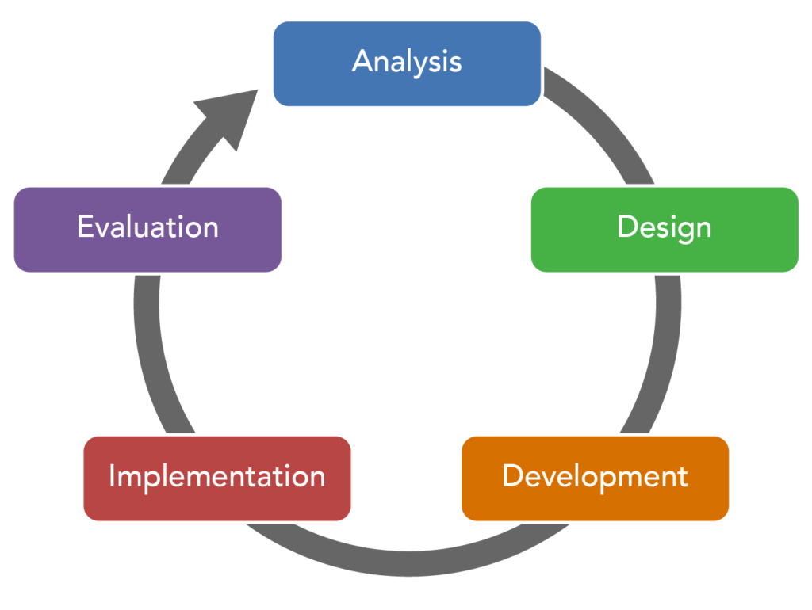
MODELLING
10

Slide 11

RESULTS
Employee performance results are a way to measure and employees Effectiveness, Efficiency, and contribution to a company’s Goals.
They can help identify areas for Improvements, align efforts with organizational goals, and support data-driven decisions.
11

Slide 12
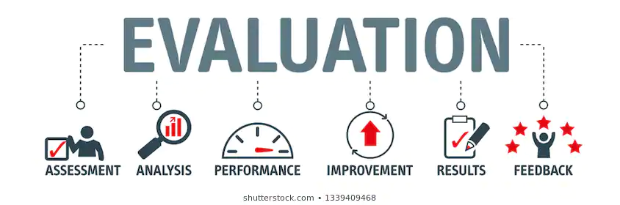
conclusion
A Conclusion for an Employee performance review should summarize the employee performance, Highlights their strengths , and identify areas for improvements.

